Slide 1


Micro-services Template
Transformers

Slide 2
Service-Based Architecture

Slide 3

GOALS
The DAEDALUS architecture has been design to answer four key questions for each flight test performed by BT&E. The four questions are:
What data will the system be required to measure or monitor?
How will the system measure or monitor that data?
How shall the data system convert that data into useful information?
How shall users identify useful pieces of information?
Constraints
Reliability / Consistency
Data consistency summarizes the validity, accuracy,
usability and integrity of related data between applications
and across the IT enterprise. This ensures that each user
observes a consistent view of the data, including visible
changes made by the user’s own transactions and
transactions of other users or processes
Reusability
Reusing libraries created by other sub systems and vice versa.
using same modules both onboard and off board systems.
Reasoning: Provide a consistent user experience and reduce redundant code. Decrease development and maintenance costs. Shorter learning curve and reduced time to bring on new users.
Security
Application security encompasses measures taken throughout
the application’s life-cycle to prevent exceptions in the security
policy of an application or the underlying system (vulnerabilities)
through flaws in the design, development, deployment, or
maintenance of the application.
Maintainability
In software engineering, the ease with which a software product can be
modified in order to:
correct defects
meet new requirements
make future maintenance easier, or
cope with a changed environment
Performance
Determine how fast some aspect of a system performs under a particular
workload. It can also serve to validate and verify other quality attributes of the
system, such as scalability, reliability and resource usage.
Scalability
Scalability is a desirable property of a system, a network, or a process,
which indicates its ability to either handle growing amounts of work in a
graceful manner, or to be readily enlarged.
High Availability
High availability is a system design protocol and associated implementation
that ensures a certain absolute degree of operational continuity during a
given measurement of time.

Slide 4
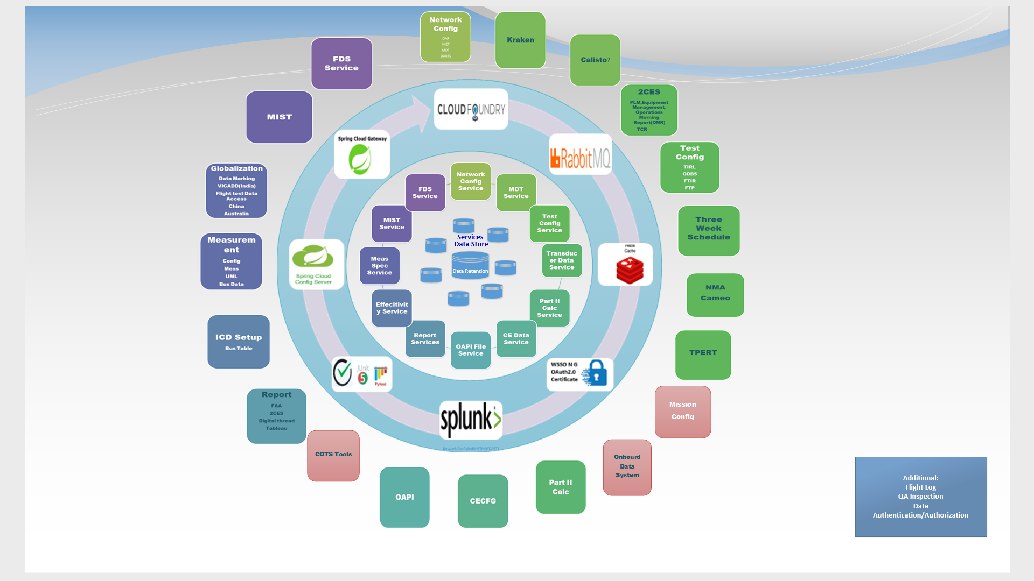
Daedalus Overview

Slide 5
Technology Recommendations
Pattern | Topic | Approach1 | Approch2 | Approach 3 (PCF) | Recommendation | TDS Tech Stack
Integration | API Gateway | IBM API Connect | UDAL Gateway | PCF Gateway | PCF Cloud Gateway for first implementation. IBM API Connect still under review | PCF Gateway
Observability | Log aggregation | Splunk | ELK | PCF App metric | SPLUNK | SPLUNK
 | Distributed tracing | Zipkin/ Sleuth |  |  | Integrated into PCF. Still under review.
 | Audit Logging | Event Sourcing | Aspect oriented |  | Event Sourcing still being reviewed in the current Sprint
Security | Authentication | WSSO NG |  | PCF WSSO NG | WSSO, OAuth, certificates, custom? UDAL still under review | PCF WSSO Tile + Custom Auth service providing JWT; Certificates in Servers
 | Authorization | IBM API Connect Authorization | UDAL Authorization/ Enterprise OAuth | PCF Gateway Authorization
 | Client – Service Service – Service | Certificate based | Token based
Reliability | Circuit Breaker | Resilience4j | PyBreaker |  | PyBreaker implementation ready in the framework, but will not be used at this time. Future consideration as services grow.
Testing Approaches | Service Integration Testing | Spring Cloud Contract & PACT tool |  |  | Service Integration Testing and Resiliency still being considered for future implementation.
 | Resiliency | Netflix Chaos-Monkey
 | Unit Test | Junit | PyTest |  | PyTest for unit testing Python. JUnit for unit testing Java Code.
Communication style | Synchronous | REST |  |  | REST | REST
 | Asynchronous | Apache Kafka | RabbitMQ |  | RabbitMQ | ActiveMQ
Cache Mechanism |  | Redis |  |  | Redis being considered for future implementation | Redis
Configuration System | Centralized Configuration | Spring Cloud Config | PCF Spring | Enterprise Provided | PCF Spring Cloud Config

Slide 6
Tech Stack :
Runtime Performance/Speed
Both Python and Java produced similar results during the performance testing. But Java has slight edge over python due to its static-typing behavior.
Reusability With respect to FTDS.
Aligning with Test Data System preferred languages is strongly recommended, as it enables reusability Of Libraries and modules across the Data system setup and processing System, in turn reduce the maintenance effort.
Also lets the I&DS ART team to collaborate.
Budget/Development Productivity
Python is perfect for projects where speed of development and budget are important,
Also, it will be easy to get developers onboard compared to Java as learning curve is less.
Application Maintainability
As Python is dynamically typed, implementations are simple than Java. Which helps in better maintainability even if the code base grows to million lines. As Java is statically typed and verbose, implementations are not simple and requires extra effort to make to code maintainable.
Data science (big data or data mining), artificial intelligence, Analytics, and machine learning, Systems which handles large amount of data.
Python shines in projects that need sophisticated data analytics and visualization ,String Manipulation
Robust Security
Java is preferable for any secure enterprise applications (ex: banking systems)
Integration with Other language libraries.
Both Java and python has well defined libraries to call function from native languages like C and C++. Support between Java and Python are very limited.
(info: Jython is not having support for Python 3)
Mobile development
Java is best suitable for mobile Development
Database Connectivity
The database access layer of Python is weaker compared to Java .Java is preferred for application dealing with complex legacy data.
Recommendation
Both Java and Python has always weighs equal with respect to programming and support,
Also has extensive library support.
It is recommended to choose the programming language which most of our teams are familiar
With, as it will improve the collaboration with less / no learning curve.
Python is preferred in place where it requires to handle large data processing and analytics.
CPU and memory utilization
Python is preferable as Java has high memory and processing requirements.

Slide 7
Recommended Languages
Target | Language | Framework | Runtime server
Front end | JavaScript | React | Node.js
Back end | Typescript / JavaScript | Express.js | Node.js
New Dev | Python | Flask | Gunicorn
Re-use/Re-write when applicable | Java | Spring boot | Java x.x
Recommended Technologies
Technology | Choice
Log aggregation, search, alerts | Splunk
Hosting platform | PCF
Security | WSSO, OAuth, certificates, custom?
Configuration | Dynamic: Spring cloud config, Static: gitlab-ci deploy
Things to think about:
Splunk team keeps logs for 3 months. If we need longer, may need to handle this ourselves
( ex: compress logs daily and archive on file share ).

Slide 8
Micro-Service Template

Slide 9
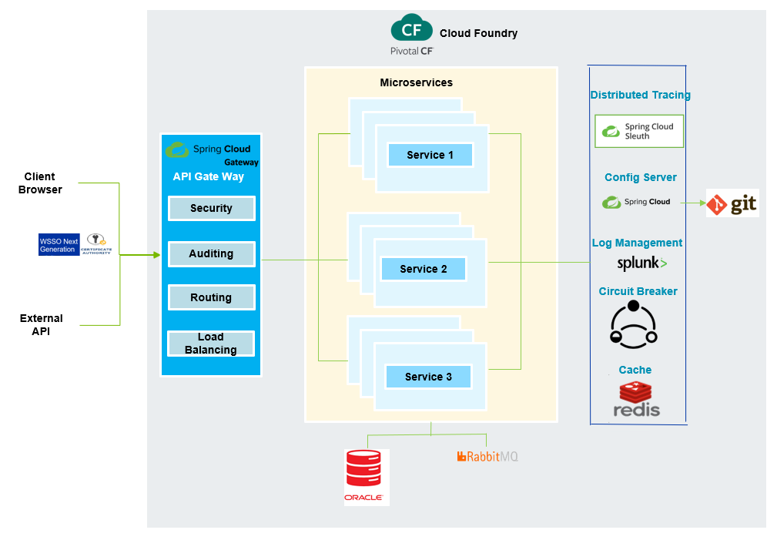
Micro-Service Architecture Template

Slide 10
Centralized Configuration
Spring Cloud Configuration Server
Niranjana Pati

Slide 11
Technology Evaluation
Pattern | Topic | Approach1 | Approch2 | Approach 3 | Recommendation
Centralized Configuration | Centralized Configuration | Spring Cloud Config Server | PCF Config Server | Custom Spring Cloud Server | PCF Config Server
Solution Approach | Externalized | Realtime Management | Maintainability | Enterprise Solution | Dashboard
Basic Spring Cloud Config Server | ✓ | ✓
PCF Config Server | ✓ | ✓ | ✓ | ✓ | ✓
Custom Spring Cloud Server | ✓ | ✓ |  | ✓

Slide 12
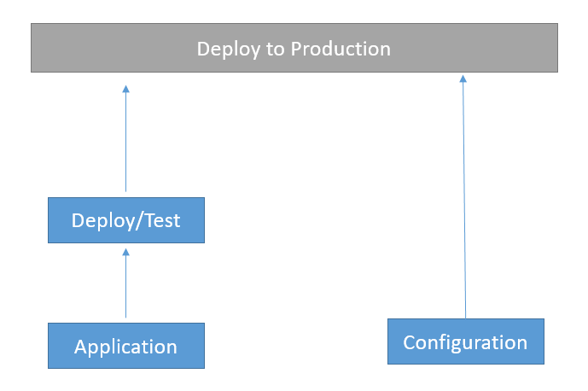
Implementation Goals
Externalized (Property Files)
Environment Specific (Spring Profile)
Consistent
Version History
Real-time Management

Slide 13
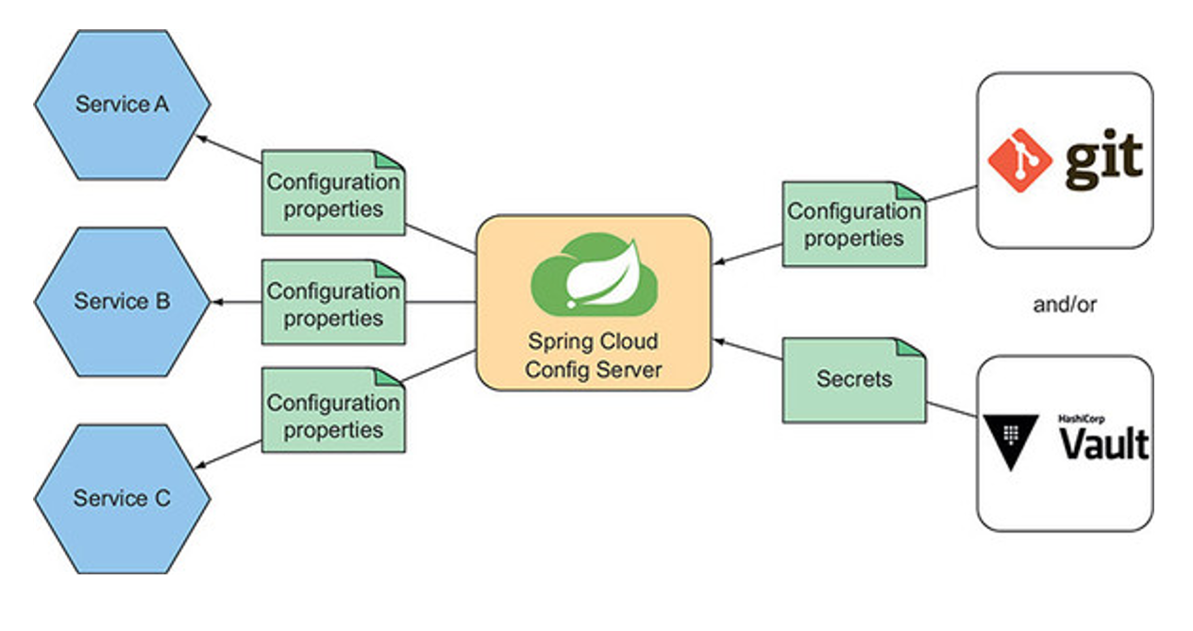
Spring Cloud Configuration Server- Architecture

Slide 14
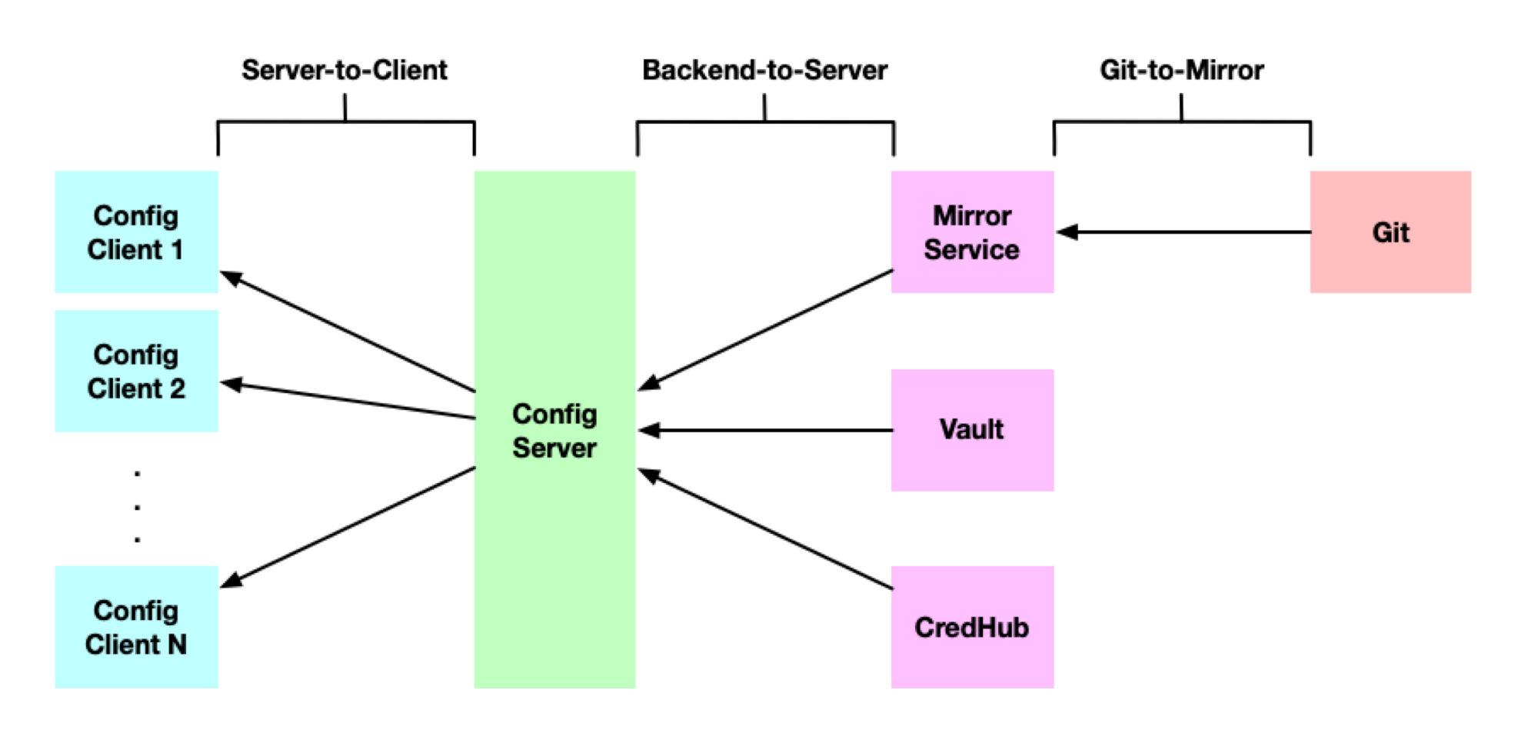
PCF Config Server - Architecture

Slide 15


Slide 16
Observability
Logging, Distributed Tracing
Log Aggregation, Distributed Tracing & App Metrics
Rajesh

Slide 17
Analysis
Observability | Topic | Approach1 | Approch2 | Approach 3
 | Log aggregation | Splunk | ELK
 | Distributed Tracing | Zipkin/ Sleuth
 | Performance Metrics | JMeter

Slide 18
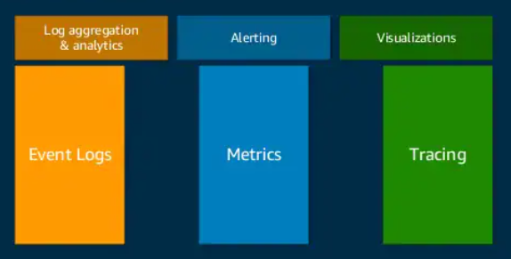
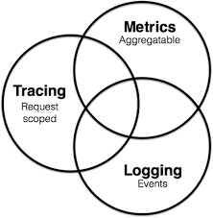
Observability
Metrics - Application metrics, Host/System metrics, Network metrics etc.
Logs - Application and supporting infrastructure logs
Traces - Track down a flow of a request through the distributed system.

Slide 19
Log Aggregation (continued…)
Microservices logging best practices:
Use a correlation ID
Structure logs appropriately
Provide informative application logs
Logs should, at a bare minimum, include the following information:
PARAMETER | DESCRIPTION
Service name | The Service name of the API or Microservice being used.
Username | An ID that is used to roll up all API and Microservices transactions related to a specific user in the system.
IP address/ Endpoint | Identifier to enumerate various back-end systems that have been accessed by an API or Microservice.
Correlation ID | The unique ID of the transaction or request that will be consistent from API to API (OR) Microservice to Microservice for traceability of a request throughout the ecosystem.
Message received time in UTC | Date and time of a transaction to the millisecond
Time taken | Time for requests to be completed
Status Code | A return code as to the success or failure of the request

Slide 20
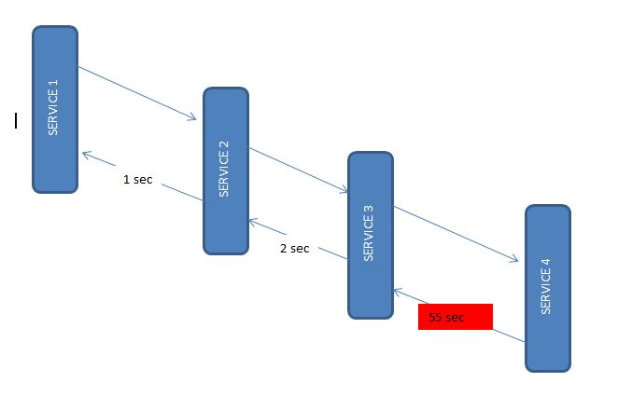
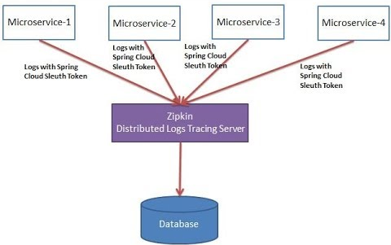
Distributed Tracing

Slide 21
Splunk vs ELK
 | SPLUNK | ELK – (KIBANA)
Performance | It is very powerful when it comes to data analyzing and processing. | It is also fast but when compared to Splunk, not so much. It still has to improve its data retrieving techniques to make it more efficient
Cost | Licensed | It is open source
Queries | Splunk Processing Language | Apache Lucene’s query syntax
Visualization | Spunk is not as interactive as Kibana but provides dashboard for log analysis. | Kibana is highly interactive and possesses a very user friendly UI.
Formats | It allows in any format JSON, CSV etc… | It allows data formats like JSON. Unlike Splunk it does not allow all kinds of data but it can be integrated with 3rd party to send the data in desired format
Data Collection | Splunk Universal forwarder | Logstash, Filebeat

Slide 22
Why Splunk?
SPLUNK
Analyze System Performance
Troubleshoot any failure condition
Monitor Business metrics
Search & Investigate a particular outcome
Dashboards
Store and Retrieve

Slide 23
Sample Splunk Implementation
Measurement Service
Network Configuration Service
Test Plan Module Service
Logs with Spring cloud sleuth
Logs with Spring cloud sleuth
Loggregator
Log Stream
Splunk Firehose Nozzle
Collects events from the PCF Loggregator endpoint and streams them to Splunk via HTTP event collector
Zipkin
Splunk Forwarder
Splunk Enterprise
Visualization of logs

Slide 24
Security
Authorization and Authentication
Gopinath and Mercy

Slide 25
Analysis
Security | Topic | Approach1 | Approch2 | Approach 3 (PCF)
 | Authentication | WSSO NG | PCF SSO Tile
 | Gateway | IBM API Connect | UDAL Gateway | PCF Gateway
 | Service – Service | Certificate based | OAuth Token

Slide 26
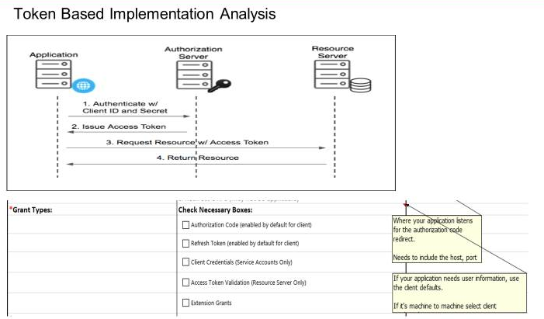
Implementation Goals
Secured access
Role based implementation
Scalable to add roles and services later

Slide 27
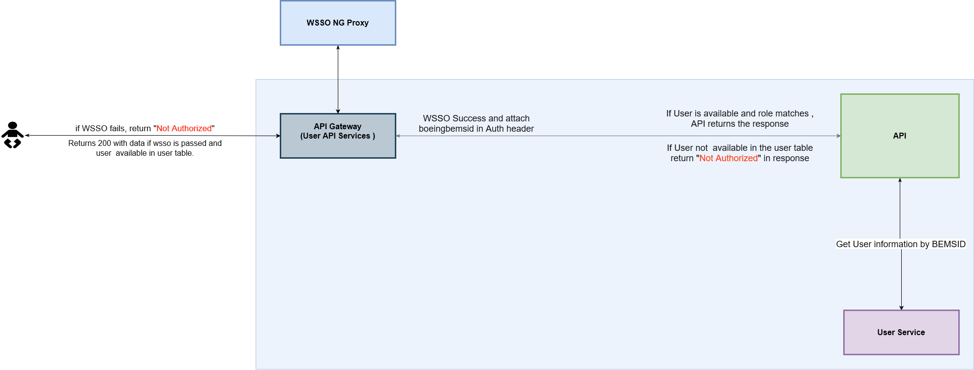
Authentication and Authorization
Considering our current requirement in DAEDALUS, we have two types of Actors who consume the DAEDALUS Services.
Human
Applications / Machine
Human authentication and authorization:
Users who are accessing the Services through
browser either by web based client application
or swagger.
WSSO lockdown enabled in API
Gateway, which requires certificate
from WSSO proxy server, which will be
Available only after successful WSSO
Logon. Other service calls will be returned
With 403 error.
https://infosec.web.boeing.com/Search/ISFindIt.aspx?aId=215
https://daedalusdocumentation.apps.pcfpre-phx.cloud.boeing.com/docs/case-studies/Application%20Security

Slide 28
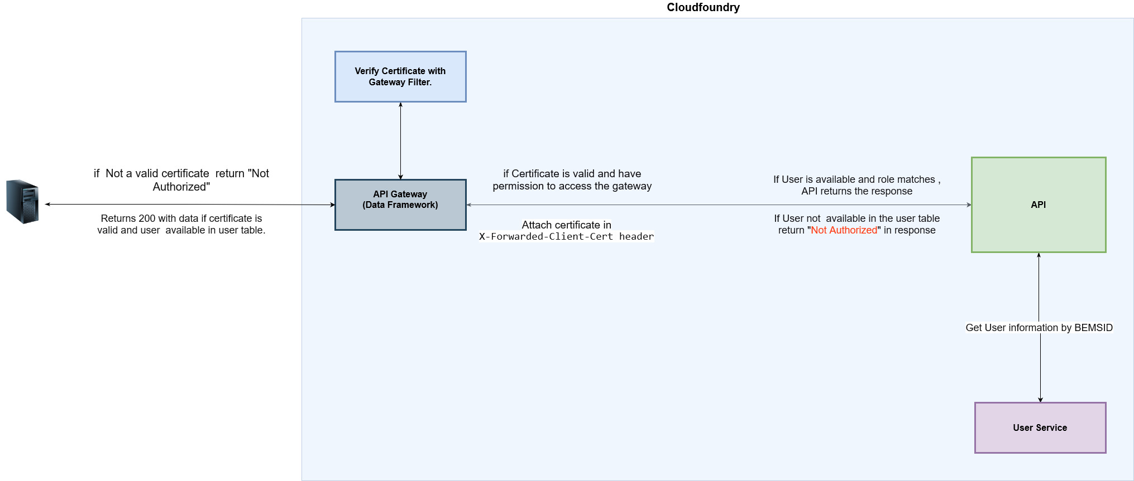
Authentication and Authorization
Application / Machine authentication and authorization:
Non human ( Applications / servers ) which are trying to access the Services must use Client certificate based on their Application BEMSID from CMI portal.
Client certificate lockdown enabled in data service
API Gateway, which requires application client certificate.
which will be acquired by the Client application
After successfully creating application BEMSID,
Client certificate from CMI portal and the BEMSID should
Be whitelisted in our gateway.
https://infosec.web.boeing.com/Search/ISFindIt.aspx?aId=71
https://daedalusdocumentation.apps.pcfpre-phx.cloud.boeing.com/docs/case-studies/Application%20Security

Slide 30
Testing Approaches
Remya

Slide 31
Testing Approaches
Types | Description | Tool/ Framework (Java)
Unit test (Automated) | The purpose is to validate that each unit of the software code performs as expected. Unit Testing is done during the development (coding phase) of an application by the developers. Unit Tests isolate a section of code and verify its correctness. A unit may be an individual function, method, procedure, module, or object. Code coverage of 70-80% is a reasonable goal for most of the projects. | Junit: Unit testing Framework used for Java programming language. It provides assertions to identify test method. PyTest: Unit testing tool used for Python programming language.
Service Integration test | Verifies communication and interactions between components are accurate to detect interface defects. When writing automated tests of the modules which interact with external components, the goal is to verify that the module can communicate sufficiently rather than to acceptance test the external component. As such, tests of this type should aim to cover basic success and error paths through the integration module | Spring Cloud Contract and PACT tool are the popular option available for Consumer Driven Contracts
Component test | Tests Microservices in isolation, with the use of mock doubles as needed, to verify they meet requirements. | Mockito and Wiremock is the go to solution for Test in isolation.
End-to-end test | Ensures all the components work together and they meet external requirements and achieve the intended functionality. | SOAPUI for API level testing Record and play Regression testing tool like Squash UFT for GUI level testing
Performance test | Test the applications for high availability, viable resource consumption and distribute workloads appropriately. | Apache Jmeter
Resiliency | The application consists of numerous services (with scaling factor) deployed across cluster. Some Services might go down – still system landscape as a whole shall stand still. | Chaos Monkey Approach- Randomly shutdown different services with a delay factor and randomly wreak havoc. Monitor the system operational benchmark.

Slide 32
Unit Testing
Prabhjot Siddhu

Slide 33
What is unit testing?
Unit testing is the smallest ‘unit’ of code being tested.
Unit tests are designed to test the behavior of specific classes or methods without relying on the behavior of their dependencies.

Slide 34
Why Unit Testing?
We take great effort to build a system or a platform with thousands of lines of code and test cycles to ensure the quality and coverage.
With QA validation being already part of the cycle, unit testing should also be considered a critical pre-step before turning the code into the build and deployment.
Thus, making sure the build is successful and achieving expected code coverage.
Unit testing has become mandatory in the age of Agile, and there are many tools available to help with automated testing.
One such tool is Mockito, an open source framework that lets you create and configure mocked objects for tests.

Slide 35
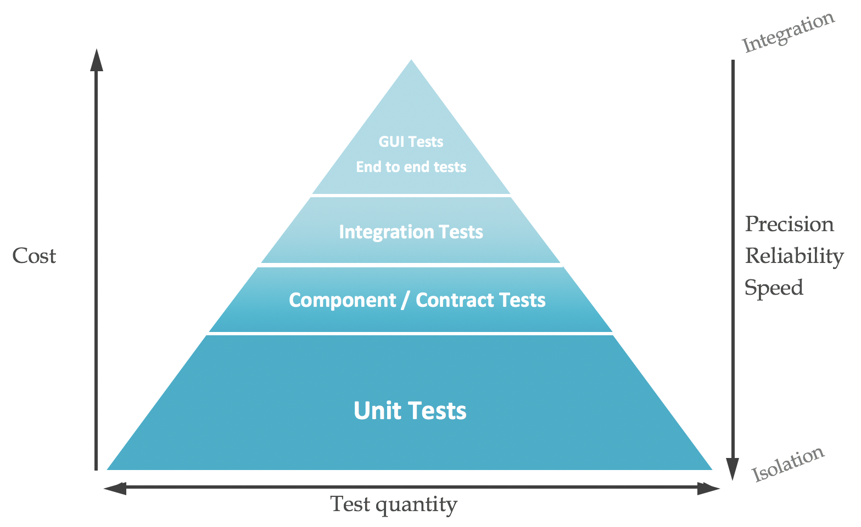
Why Unit testing?

Slide 36
Design and implementation using Mocking
Mocking is a way of producing dummy objects, operations, and results as if they were real scenarios. This means that it deals with no real database connections and no real server up and running.
However, it mimics them so that the lines are also covered and expect the actual result. Thus, it can be compared with the expected result and asserted.
Mockito provides various annotation and in-build methods for unit testing.
Mockito.when().then()

Slide 37
Mocking

Slide 38
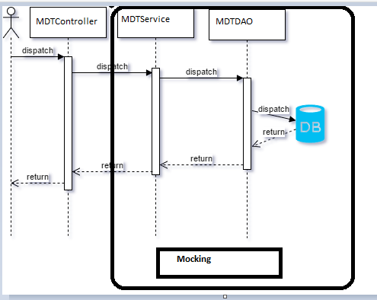
Implementation

Slide 39
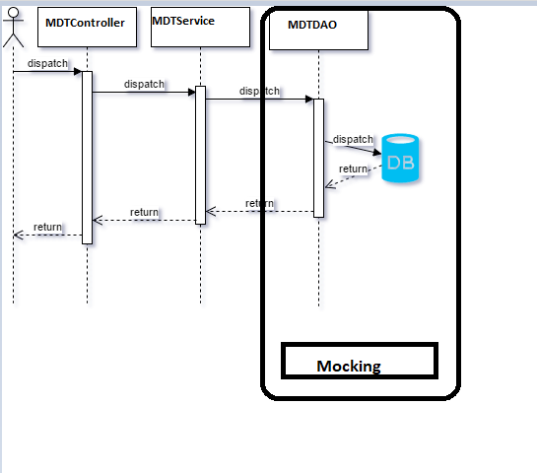
Implementation

Slide 40
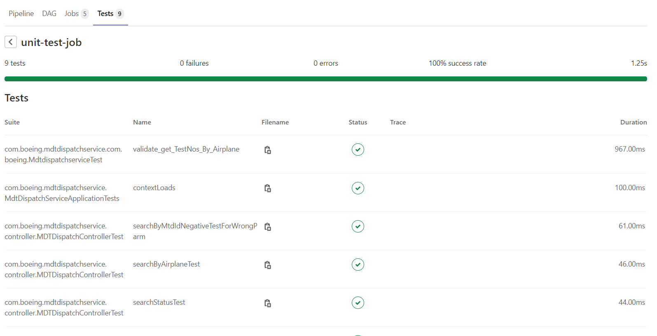
Unit Test job in Pipeline

Slide 41
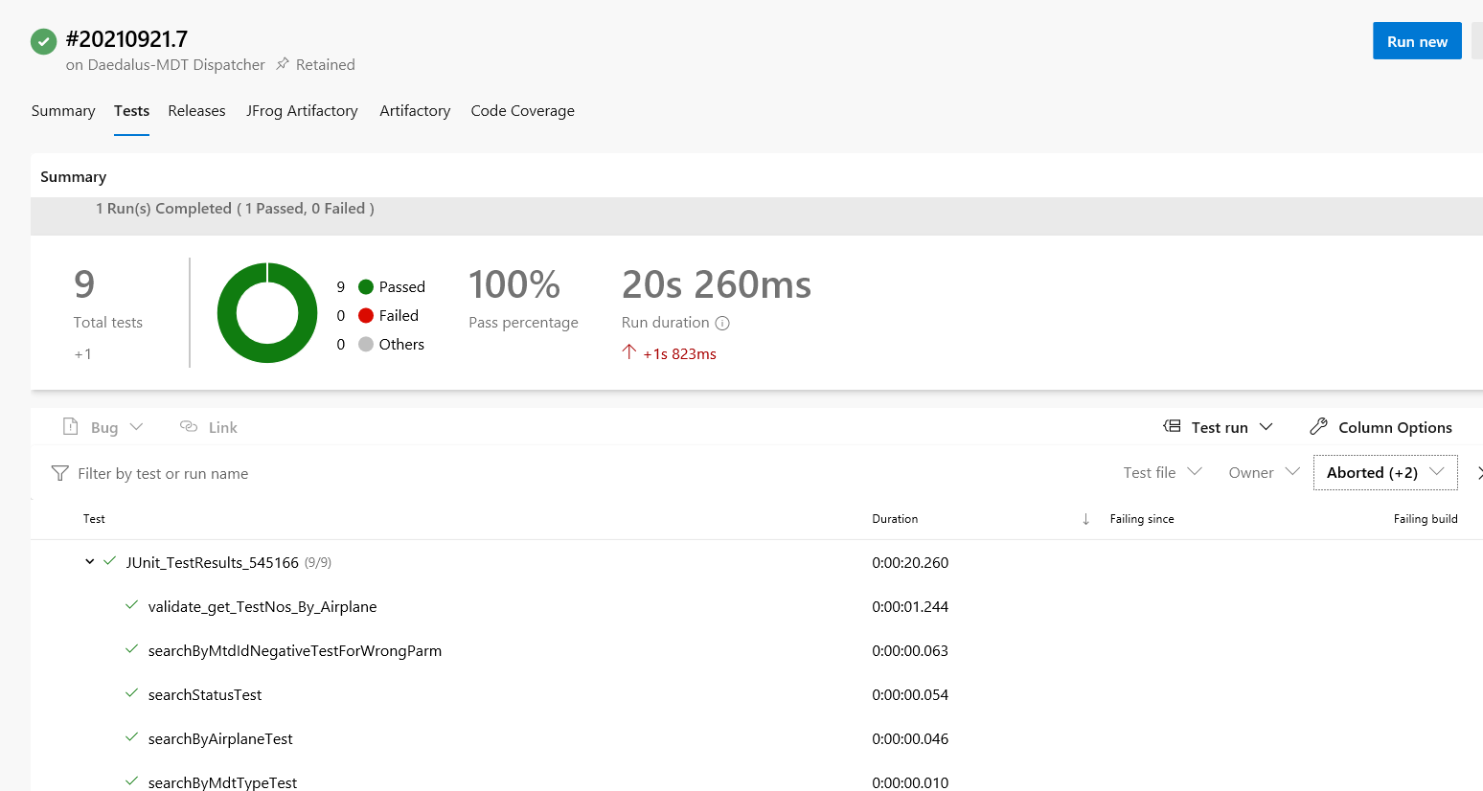
Unit Test job in Pipeline

Slide 42
Integration Testing
Remya Suresh

Slide 43
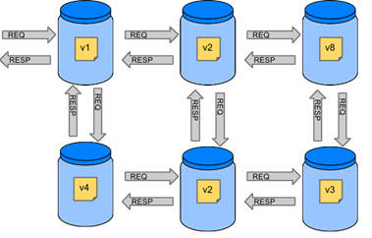
Integration Testing Approach
Traditional Approach
if we want to test the application in the top left corner of the image to determine whether it can communicate with other services, we have to Deploy all micro services and perform end-to-end tests.
Advantages:
Simulates production and tests real communication between services.
Disadvantages:
To test one micro service, we have to deploy six microservices, a couple of databases, and other items.
The environment where the tests run is locked for a single suite of tests (nobody else would be able to run the tests in the meantime).
They take a long time to run.
The feedback comes very late in the process.
They are extremely hard to debug.

Slide 44
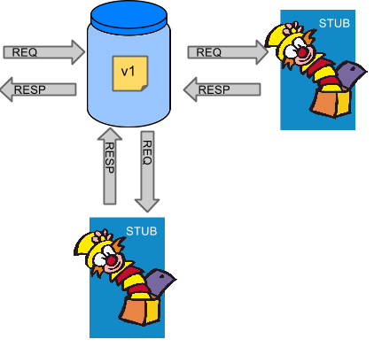
Service Integration Contract Test
Contract testing is a methodology for ensuring that two separate systems such as two micro services are compatible and are able to communicate with one other. It captures the interactions that are exchanged between each service, storing them in a contract, which can then be used to verify that both parties adhere to it
Spring Cloud Contract is one of the popular option available for Consumer Driven Contracts. It gives you the certainty that the stubs that you use were created by the service that you call. Also, it means that they were tested against the producer’s side. In short, you can trust those stubs..
The main idea is to give you very fast feedback, without the need to set up the whole world of micro services If you work on stubs, then the only applications you need are those that your application directly uses

Slide 45
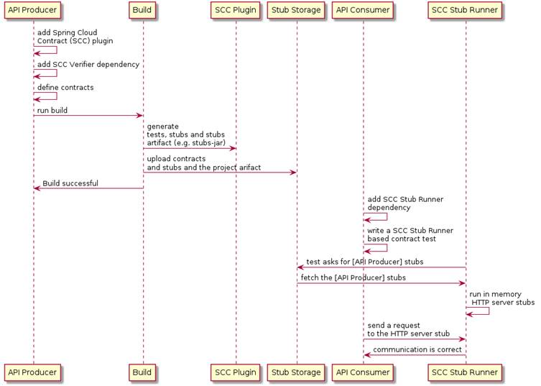
UML diagram shows the relationship of the parts within Spring Cloud Contract:
Spring Cloud Contract is an umbrella project that holds solutions to help users implement contract tests. It has two main modules:
Spring Cloud Contract Verifier, which is used mainly by the producer side.
Spring Cloud Contract Stub Runner, which is used by the consumer side.
Spring Cloud Contract Verifier creates a stub from the producer service which can be used by the consumer service to mock the calls. This provides both faster feedback and makes sure our tests actually reflect the code. This ensures the contract between a Producer and a Consumer, for both HTTP-based and message-based interactions.
Spring Cloud Contracts allows us to define contracts using Groovy DSL, YAML, PACT JSON, Spring Rest Docs.These Contracts are usually stored in a Producer repository or in a centralized repository where both consumers and producers can have access to it.

Slide 46
Communication
Synchronous & Asynchronous
Govind

Slide 47
Analysis
Communication | Topic | Approach1 | Approch2
 | Synchronous | REST | SOAP
 | Asynchronous | Apache Kafka | RabbitMQ

Slide 48
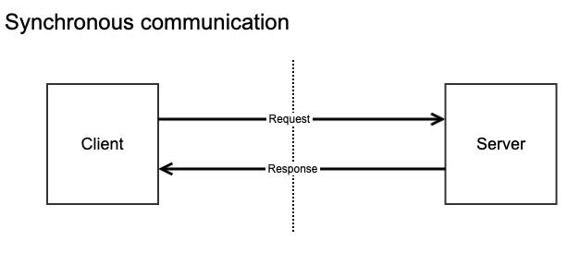
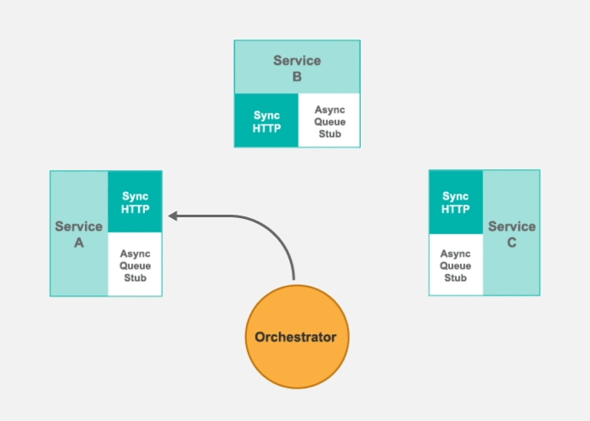
AES-MD5 Secure Encryption
API Gateway

Slide 49
Synchronous Communication
Properties | SOAP | REST
Style | SOAP is a protocol. | REST is an Architectural style
Function | Function driven - transfer structured information | Data driven - access a resource for data
Bandwidth | SOAP requires more bandwidth for its usage. | REST does not need much bandwidth.
Data format | SOAP can only work with XML format. | REST permits different data format HTML, XML, JSON, etc…
Security | Supports WS security and SSL | Supports SSL and HTTPS
Data Cache | Cannot be Cached | Can be Cached
Payload handling | Needs knowledge of everything before any interaction | Needs no knowledge of API
Performance | Slower as it needs some additional process | Faster

Slide 50
Asynchronous Communication
Asynchronous Communication | Apache Kafka | RabbitMQ
 | Useful for where message communication is of streaming data type. Ex – voice message | Useful for our project where communication rate is not heavy.
 | Useful where data flow rate is ~1million msg / sec | Useful where data flow rate is around ~200 msg / sec
 | Because of its capacity of data handling, it is designed heavyweight and requires more memory | It consumes very less memory when compared to Kafka as its capacity of data handling is less
 | Support from Boeing enterprise | PCF is being supported by Boeing enterprise so is Rabbit MQ
 | Highest throughput | Relatively lower throughput
 | Kafka provides the lowest latency at higher throughputs, while also providing strong durability and high availability | RabbitMQ can achieve lower end-to-end latency than Kafka but only at significantly lower throughputs

Slide 51

Questions?

Slide 52
Questions?

Slide 53
Integration
API Gateways

Slide 54
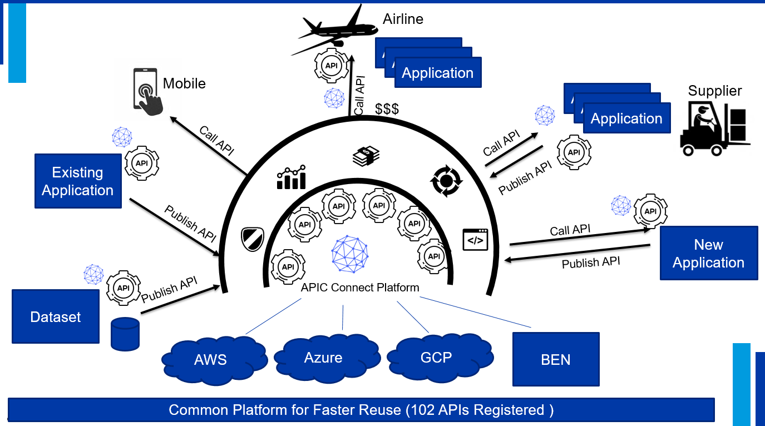
API Economy

Slide 55
API Connect Personas and Use Cases
John
API Creator
In charge of development
His goal is to build and test APIs
Works within the construct of her Org in Sandbox
Seema
API Lifecycle Manager
LOB Lead, Reviews & Manager approvals of APIs and version updates
Goal is to ensure APIs are current in Production environment
Laura
API & App Developer
She is interested in building new applications & web services
Her journey starts with API developer portal, registering applications and discovering related APIs
Bob
API Operations/ Administration
Bob is the infrastructure and operations lead for APIM tools. His goal is to ensure teams are secured through the API lifecycle, environment is available
Set up team spaces and manages CI-CD pipeline
Creation & Publishing
of API
Consumption of API
API Manager & Analytics
As a developer, I would like to publish my APIs in APIC
API Creation
Dedicated Org Sandbox
WSSO
Application Creation
API Testing
As a Dev lead or Manager, I would like to discover existing APIs prior to committing new development to minimize costs to my org
API Portal
Subscription
WSSO
Public face of APIC
API Discovery
Socialize
As a API Product Owner, I would like to review the API event calls and metrics to identify KPIs
Manage
Visualizing
WSSO
Event Logs
Analytics
Sandbox - Provider Org
Dev| IUT | IFT | Prod

Slide 56
Analysis
Parameter | IBM API Gateway | PCF Spring Cloud Gateway | UDAL Gateway (Data as Service)
Proxy Server | Yes | Yes | Yes
Offload Authentication and Authorization responsibility | Yes (Custom Auth provider option available) | Yes, PaaS has the capability but yet to explore the custom role authorization | Yes
Product Catalog feature | Yes (Advanced) | No | Yes (Basic)
Workflow/ Transformation/ Aggregate multiple request | Yes | No | No
Cloud Native/ Multi cloud Facility | Yes | No | Yes, but not validated in other PaaS
API analytics and metrics | Yes | No | No

Slide 57
PCF Gateway

Slide 58
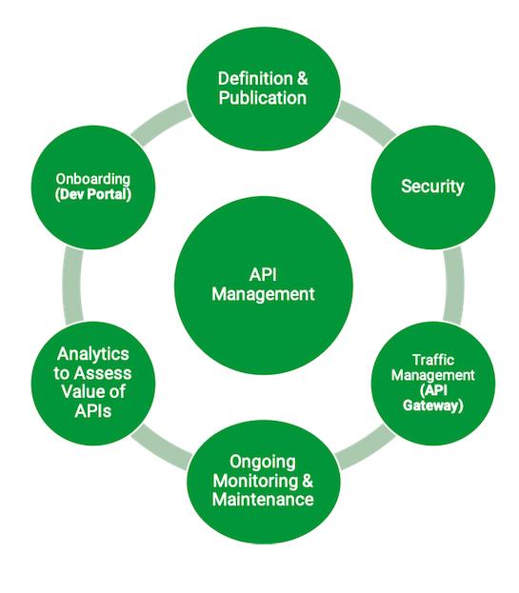
API Management
PCF provides infrastructure to achieve
Security
Auditing (API Analytics)
Load Balancing
Routing
API Gateway
are the major pillars of API Management.
Also, we will be able to customize the provision of Dev portal for onboarding & support through mattermost.
The above implementation is simple and easy to manage and yet powerful in handling our requirements and we will have full control over it.
Also, with respect to security we will not be exposing the services to another layer outside PCF for API management.

Slide 59
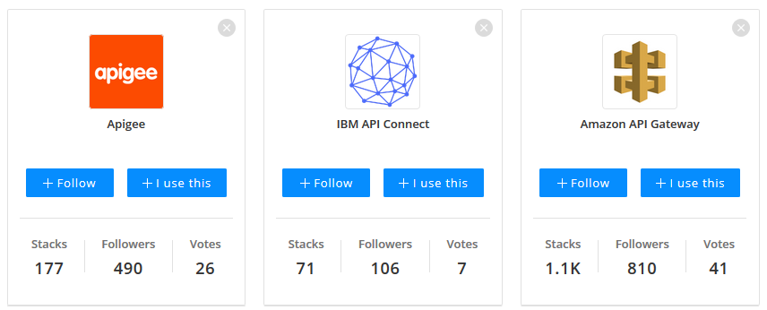
If we migrate to any other cloud platform
It will be easy to deploy the applications without / less code change as we used WSSO and Client certificate for authentication, as the two methods is already available there.
We can subscribe API management tool like Apigee and amazon AWS gateway as a service which is available inside the Cloud platform without exposing the application outside for API management.
https://stackshare.io/stackups/apigee-vs-ibm-api-connect-vs-amazon-api-gateway

Slide 60
Reliability
Circuit Breaker

Slide 61
Reliability – A challenge for an efficient communication
It’s the capacity of handling the failures during the communication.
So what I mean by failures? It can be…..
Node level failure – Hardware failure
Be overwhelmed with the request and unable to process any new requests
momentary loss of network connectivity to components and services
temporary unavailability of a service
time-outs that occur when a service is busy.

Slide 62
What is the solution for communication failure ?
---A solution lies in the design patterns
1. Retry
A network call may fail because of a transient fault that goes away by itself. Rather than fail outright, the caller should typically retry the operation a certain number of times, or until a configured time-out period elapses.
2.Circuit Breaker
Too many failed requests can cause a bottleneck, as pending requests accumulate in the queue. These blocked requests might hold critical system resources such as memory, threads, database connections, and so on, which can cause cascading failures.
The Circuit Breaker pattern can prevent a service from repeatedly trying an operation that is likely to fail.

Slide 63
Retry Design Pattern
In the cloud, transient faults aren't uncommon and an application should be designed to handle them elegantly and transparently.
So what kind of strategies does retry design pattern displays?
Cancel- If the fault indicates that the failure isn't transient or is unlikely to be successful. How to know if the fault is transient or not? That’s easy. Just using the status code. In this case the application should cancel the operation and report an exception. Example: Authentication failure caused by providing invalid.
Retry- If the specific fault reported is unusual or rare, it might have been caused by unusual circumstances such as a network packet becoming corrupted while it was being transmitted.
Retry after delay- If the fault is caused by busy network. The application should wait for a suitable time before retrying the request

Slide 64
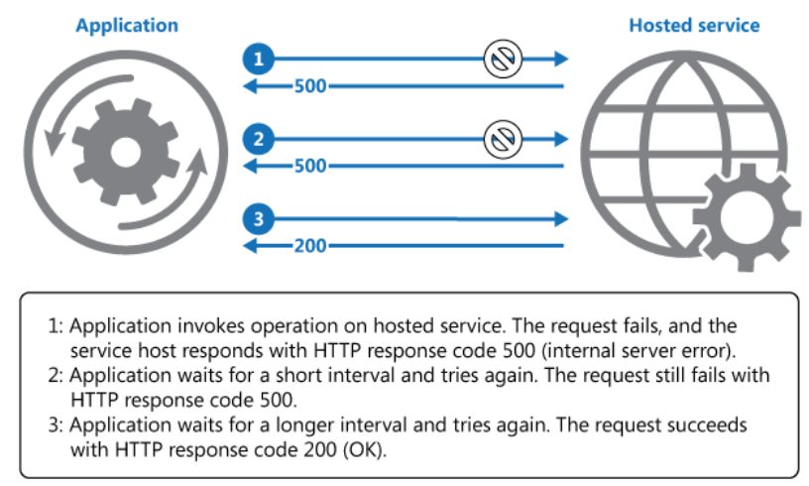
When Retry pattern might not be useful ?
When a fault is likely to be long lasting.
Internal exceptions caused by errors in the business logic of an application.
As an alternative to addressing scalability issues in a system.

Slide 65
Circuit Breaker
Application should quickly accept that the operation has failed and handle this failure accordingly.
It can prevent an application from repeatedly trying to execute an operation that's likely to fail.
The Circuit Breaker pattern also enables an application to detect whether the fault has been resolved.
A circuit breaker acts as a proxy for operations that might fail. The proxy should monitor the number of recent failures that have occurred, and use this information to decide whether to allow the operation to proceed, or simply return an exception immediately.

Slide 66
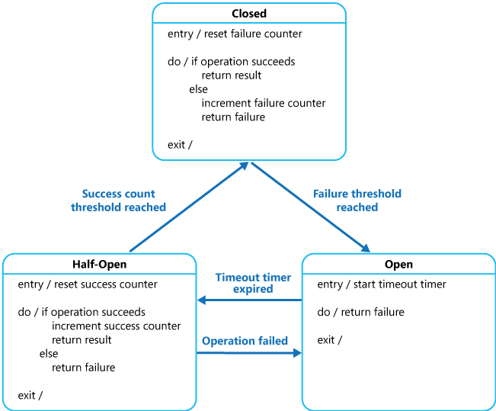
Closed , Open , Half-Open State
Open- The failure threshold that trips the circuit breaker into the Open state is only reached when a specified number of failures have occurred during a specified interval.
Closed- The circuit breaker reverts to the Closed state after a specified number of consecutive operation invocations have been successful. Default state.
Half-Open- The counter used by the Half-Open state records the number of successful attempts to invoke the operation.

Slide 67
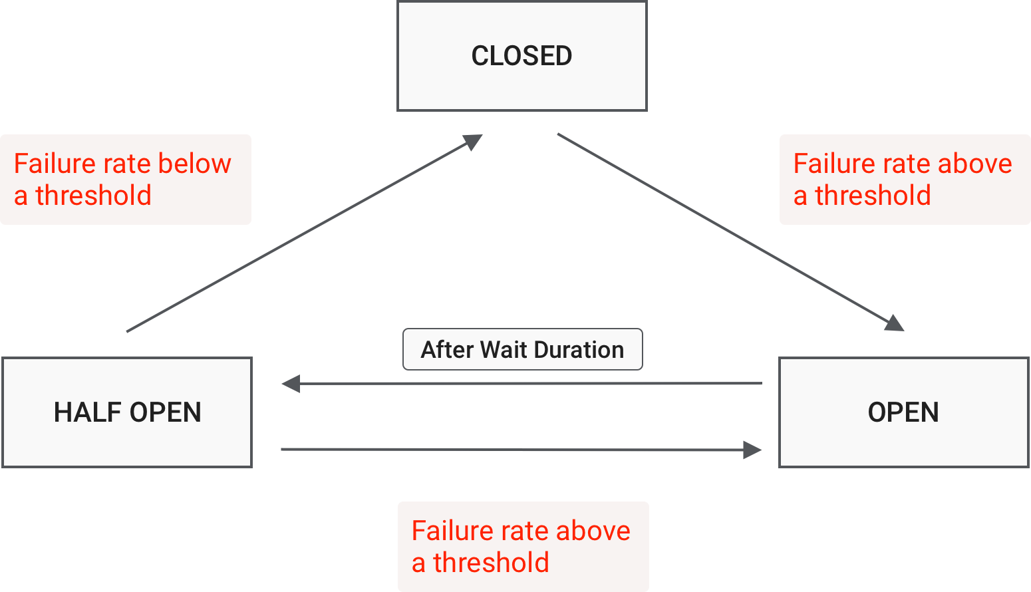
Circuit Breaker- Finite State Machine
The circuit breaker wraps a function call inside the circuit breaker object, which continuously monitors for failures.
Once failure reaches the defined threshold, the circuit breaker trips, and all further calls to the circuit breaker return with an error, without the wrapped function getting called.

Slide 68
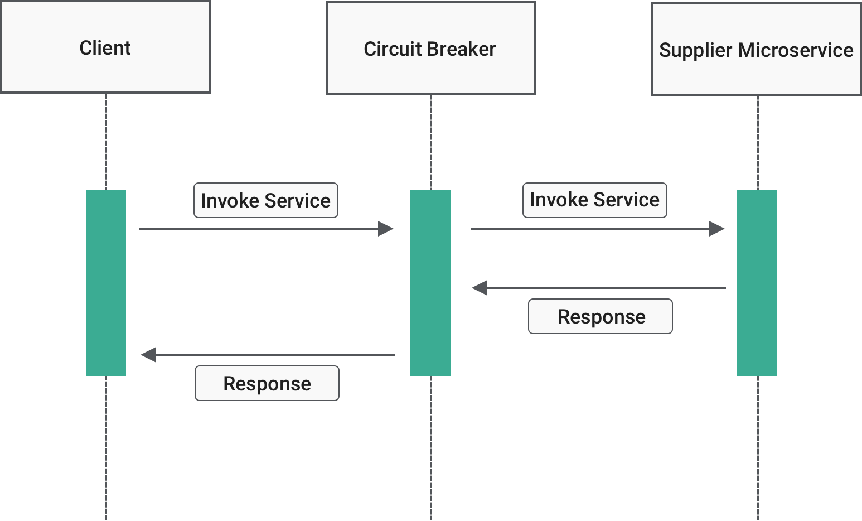
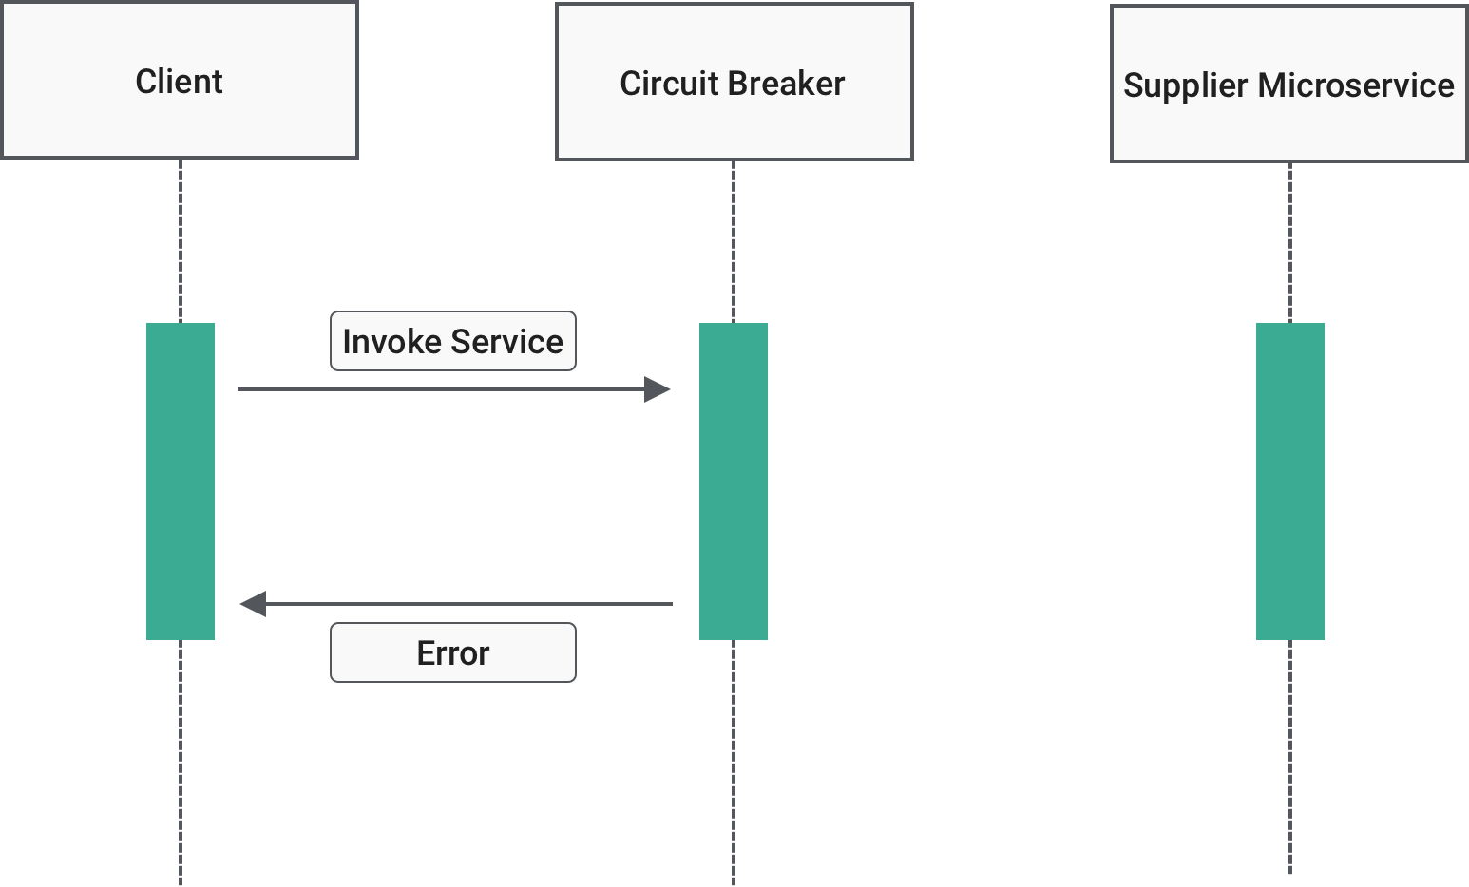
Closed , Open State
CLOSED STATE
OPEN STATE

Slide 69
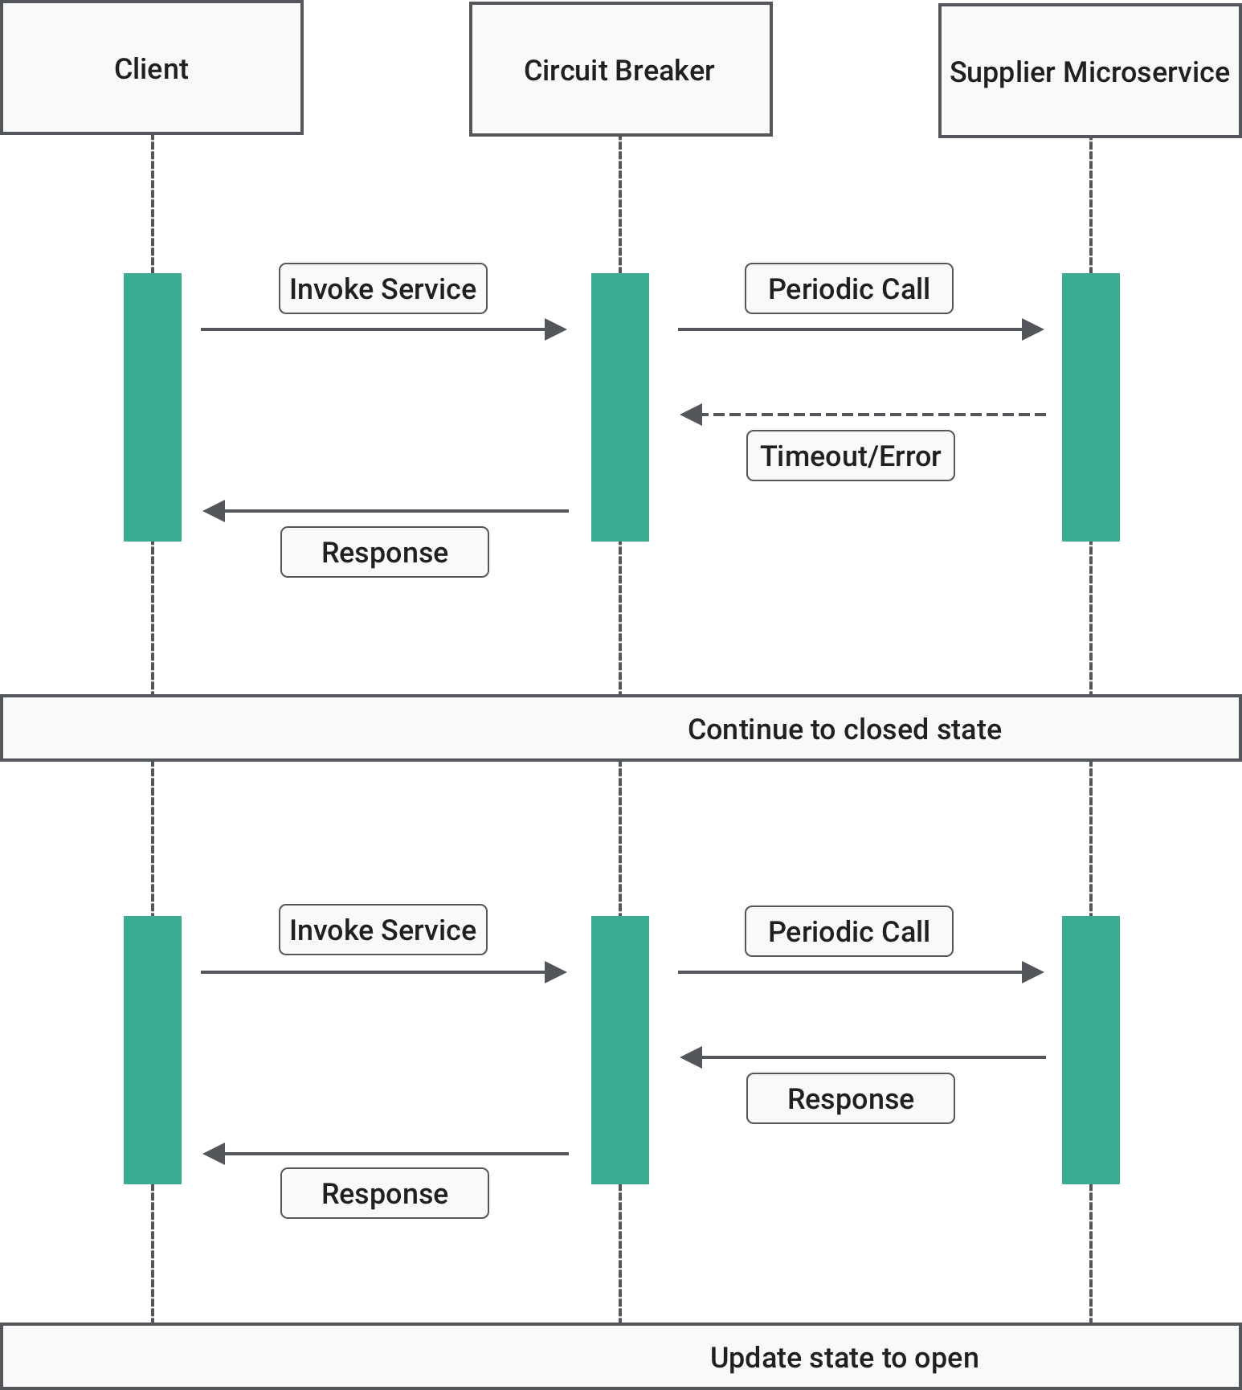
Half-Open State
HALF-OPEN STATE

Slide 70
Libraries for Integrating circuit breaker
There are several open-source libraries available for integrating the circuit breaker:
Resilience4j
Netflix Hystrix
Sentinel by Alibaba
Failsafe
Service Mesh like Istio, Linkerd, Cilium etc.

Slide 71
Recommended – Resilience4j
Hystrix | Reslilience4j
Open source library offered by Netflix | Standalone library inspired by Hystrix but build on the principles of functional programming
Complex compared to Resilience4j | easy-to-use , designed for Java 8 itself
Heavy weight because has a compile dependency to Archaius which has many more external library dependencies such as Guava and Apache Commons Configuration. | Light weight because the library only uses Vavr, which does not have any other external library dependencies.
Calls to external systems have to be wrapped in a HystrixCommand | Provides higher-order functions (decorators) to enhance any functional interface, lambda expression or method reference with a Circuit Breaker, Rate Limiter or Bulkhead. Furthermore, the library provides decorators to retry failed calls or cache call results.
Hystrix only performs a single execution when in half-open state to determine whether to close a CircuitBreaker. | Allows to perform a configurable number of executions and compares the result against a configurable threshold to determine whether to close a CircuitBreaker.

Slide 72
FAIL OVER???

Slide 73
Cache Mechanism
Logging, Distributed Tracing
Redis

Slide 74
Spring Boot POC
Performance Testing

Slide 75
DEMO OF Manage Program; Mange User Microservice
and
MEAS Service POC

Slide 76
Performance Report
60 users; 30 Loops;
Increasing every 8 Seconds
Loading 12K measurements for MOCKBNSI Airplane.
PARAMETER | DESCRIPTION | SPRING BOOT | PYTHON
Database Connectivity |  | ↑ | ↓
Robust Security | Is the ability of a computer system to cope with errors during execution and cope with erroneous input | ↑ | ↓
Mobile development |  | ↑ | ↓
Enterprise Library support | Is a collection of reusable application blocks designed to assist software developers with common enterprise development challenges | ↑ | ↓
Stability of the code | The source code is stable when changes to it are delimited to interrelated parts of the source code base (architecturally related components) | ↑
Runtime Performance/ SPEED |  | ↑ | ↓
CPU and memory utilization |  | ↓ | ↑
Budget/Development Productivity |  | ↓ | ↑
Data science (big data or data mining), Artificial Intelligence & Machine Learning |  | ↓ | ↑

Slide 77
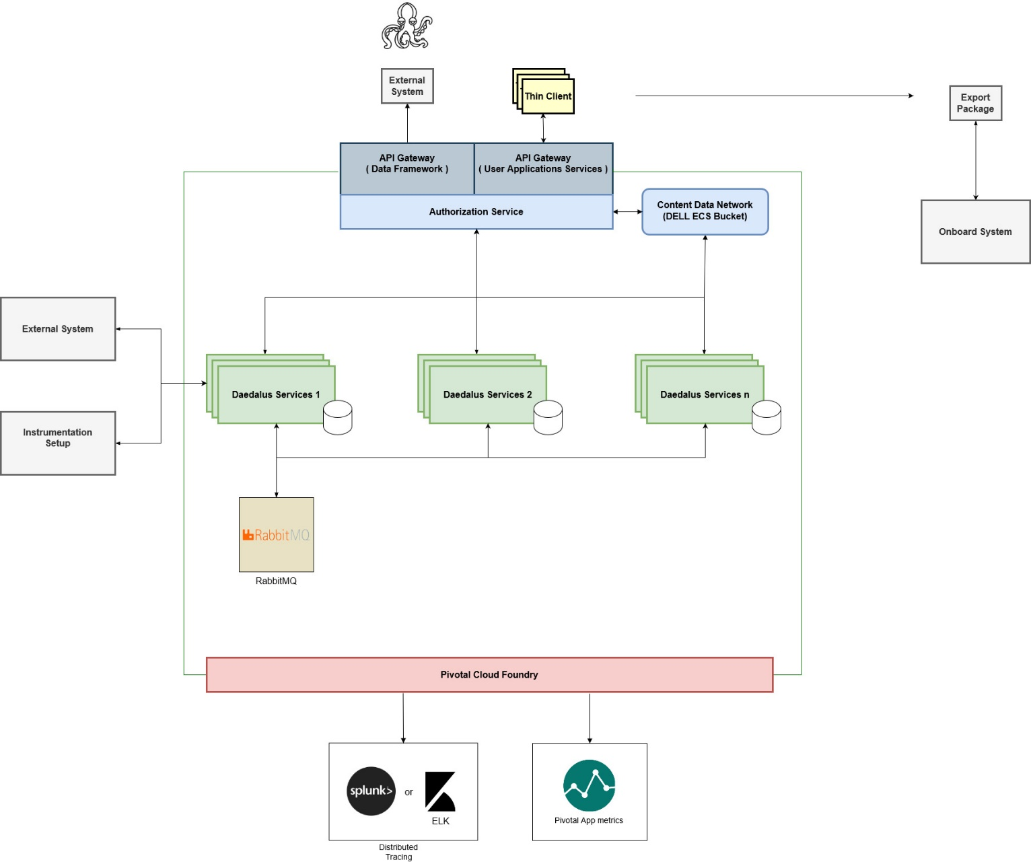

Logical view of Daedalus System
Scope:
Ingesting calibrations, configurations, interface definitions, and test information. This will be from developed user interfaces, parsers, or interfaces to external systems.
Outputting required parameter, measurement, and condition information to the data processing, selection, and transformation sub-system so that it can correctly determine how to read, write, and convert acquired time-stamped Ethernet packets in to useful information and data ( referred to here as EU )
Outputting instrumentation block points that consist of the required information to configure and setup an installed instrumentation package
Storing all information used to define a test along with the data collected for it Being able to re-load an instance of the system with just the required information for a test.
The logical overview of the System consist of
A handful of internal services that provide required capabilities.
Export packages in the form of a set of files that comprise a sub-set of system information that can be used to re-generate an instance of the system for executing a test (usually on-board the aircraft).
Gateway APIs that are used to aggregate required information and tailor interfaces for user applications or for external sub-systems (i.e. Data Processing).
Parsers that can convert external system formats into common internal abstractions. Will also store the parsed file so that it can be used natively for setting up the acquisition sub-system using the same set of tools used to generate it.

Slide 78
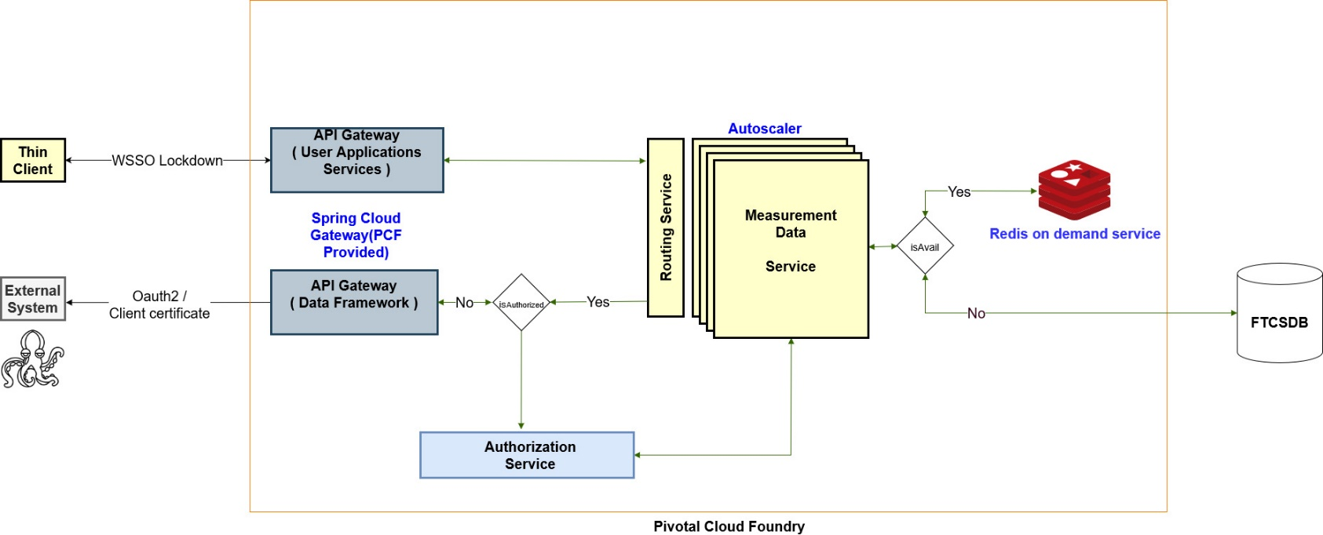
Architecture
Authentication
WSSO lockdown for User api gateway.
Client certificate authentication
for data framework api Gateway
PCF Services
Gateway
Autoscaler
Redis cache on demand instance
Log aggregation
App metrics

Slide 79
References:
System Architecture Document:
https://daedaluspoc-dev-wsso.apps.boeing.com/daedalusdocumentation/docs/system-architecture/Introduction
Performance test result
https://daedaluspoc-dev-wsso.apps.boeing.com/daedalusdocumentation/docs/markdown-features/tabs
Case Study
https://www.infoq.com/articles/github-monolith-microservices/
POC Implementation
https://daedaluspoc-dev-wsso.apps.boeing.com/bonsai

Slide 80
Questions?

Slide 82
Sample ELK Stack Implementation
Measurement Service
Network Configuration Service
Test Plan Module Service
Logs with Spring cloud sleuth, Zipkin
Logs with Spring cloud sleuth, Zipkin
Loggregator
Log Stream
Logstash
Collects logs from Measurement and other services, transforms them
Zipkin
Elastic Search
Kibana
Request flow visualization
Log Storage
Visualization of logs

